Slide 1
User Interface Design Principles
Lecturer: Ngo Huy Bien
Software Engineering Department
Faculty of Information Technology
VNUHCM - University of Science
Ho Chi Minh City, Vietnam
nhbien@fit.hcmus.edu.vn

Slide 2

Objectives
To evaluate user interface designs using principles.

Slide 3

Contents
User Interface Design Principles
Web Accessibility

Slide 4

References
William Lidwell, Kritina Holden and Jill Butler (2010). Universal Principles of Design. Rockport Publishers.

Slide 5
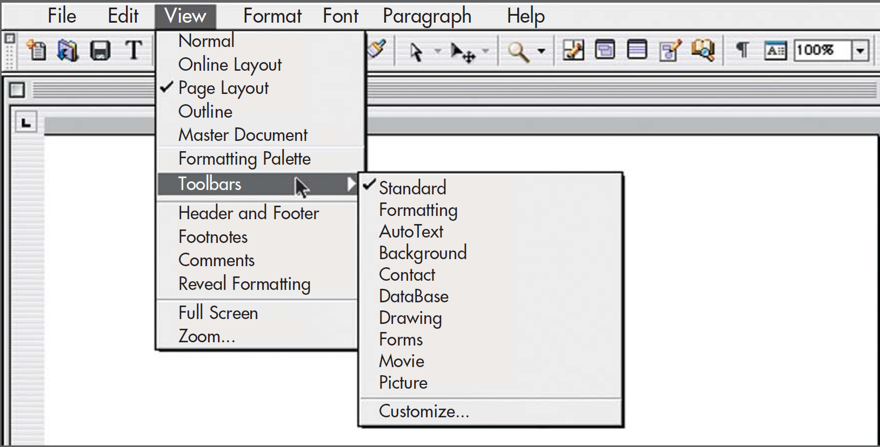
80/20 Rule [1]
Identifying the critical 20 percent of the functions and making them readily available in toolbars.

Slide 6
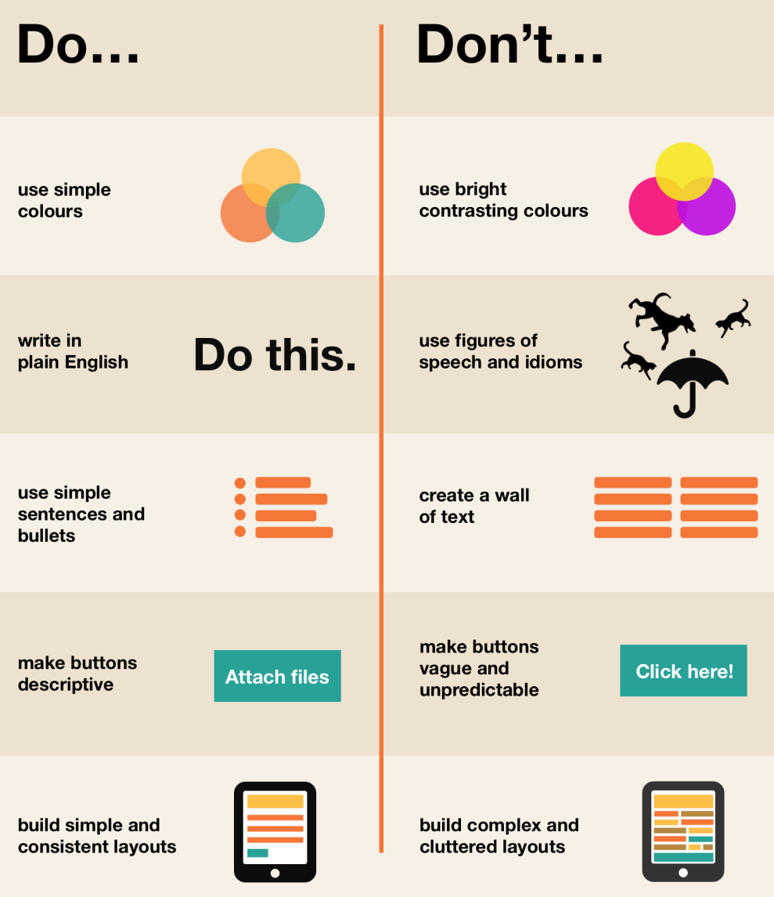
Accessibility
Objects and environments should be designed to be usable, without modification, by as many people as possible.

Slide 7
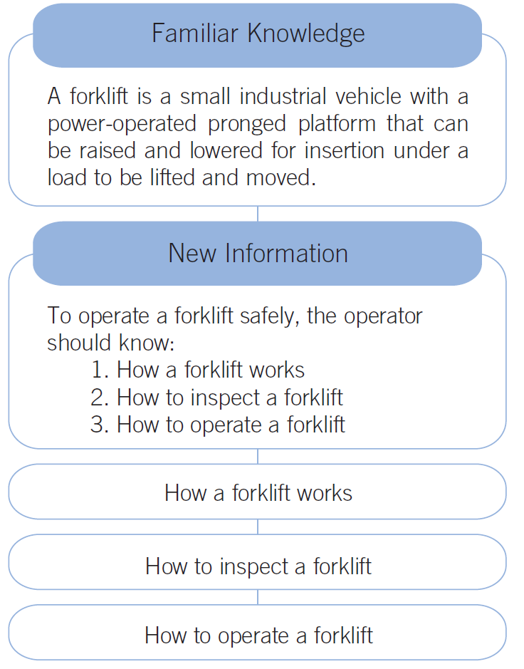
Advance Organizer
Advance organizers are brief chunks of information — spoken, written, or illustrated — presented prior to new material to help facilitate learning and understanding.

Slide 8
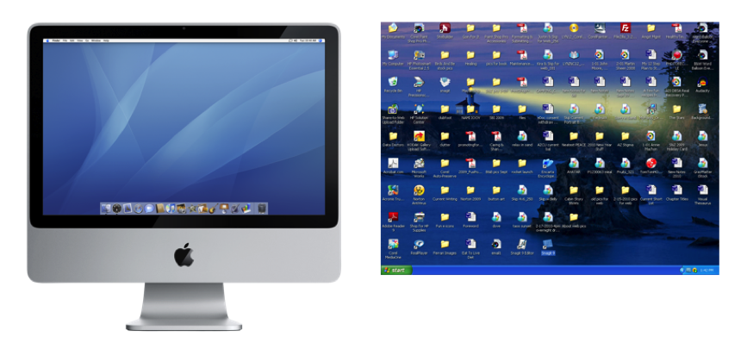
Aesthetic-Usability Effect
The aesthetic-usability effect describes a phenomenon in which people perceive more-aesthetic designs as easier to use than less-aesthetic designs—whether they are or not.

Slide 9
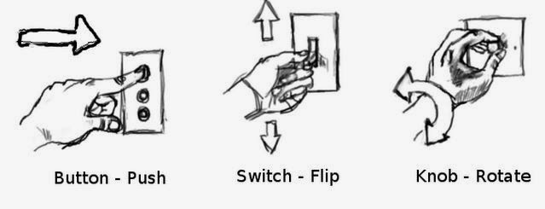
Affordance
Objects and environments are better suited for some functions than others.
Round wheels are better suited than square wheels for rolling; therefore, round wheels are said to better afford rolling.
Stairs are better suited than fences for climbing; therefore, stairs are said to better afford climbing.

Slide 10

Alignment
Elements in a design should be aligned with one or more other elements.
This creates a sense of unity and cohesion, which contributes to the design’s overall aesthetic and perceived stability.

Slide 11

Closure
Whenever possible, people tend to perceive a set of individual elements as a single, recognizable pattern, rather than multiple, individual elements.
The tendency to perceive a single pattern is so strong that people will close gaps and fill in missing information to complete the pattern if necessary.
The principle of closure enables designers to reduce complexity by reducing the number of elements needed to organize and communicate information.
Elements in text and graphics can be minimized to allow viewers to participate in the completion of the pattern.

Slide 12
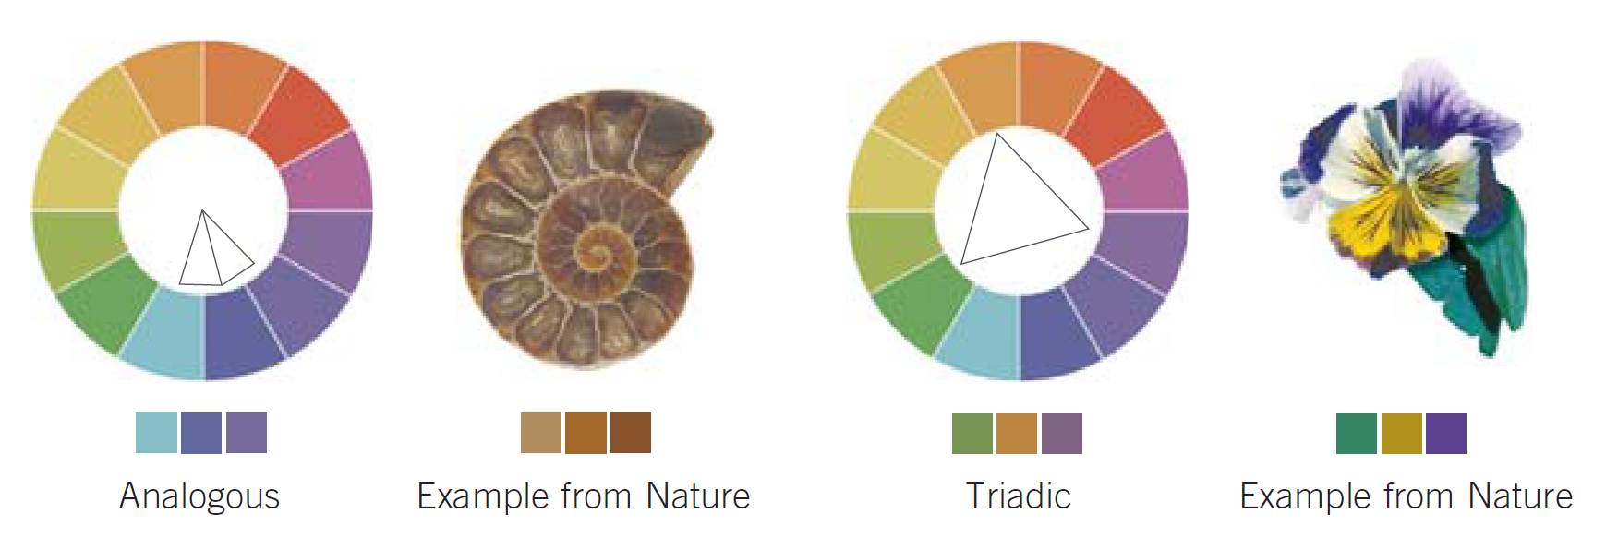
Color
Limit the palette to what the eye can process at one glance (about five colors depending on the complexity of the design).
Achieve aesthetic color combinations by using adjacent colors on the color wheel (analogous), opposing colors on the color wheel (complementary), colors at the corners of a symmetrical polygon circumscribed in the color wheel (triadic and quadratic), or color combinations found in nature.

Slide 13
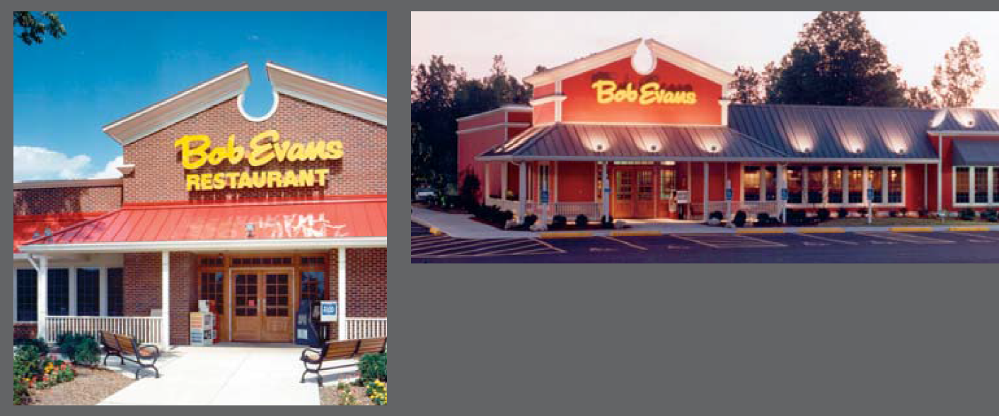
Consistency
According to the principle of consistency, systems are more usable and learnable when similar parts are expressed in similar ways.
Consistency enables people to efficiently transfer knowledge to new contexts, learn new things quickly, and focus attention on the relevant aspects of a task.
Use consistent approaches when possible, but do not compromise clarity or usability for consistency. In
Restaurant chains frequently use consistency to provide customers with the same experience across many locations.

Slide 14
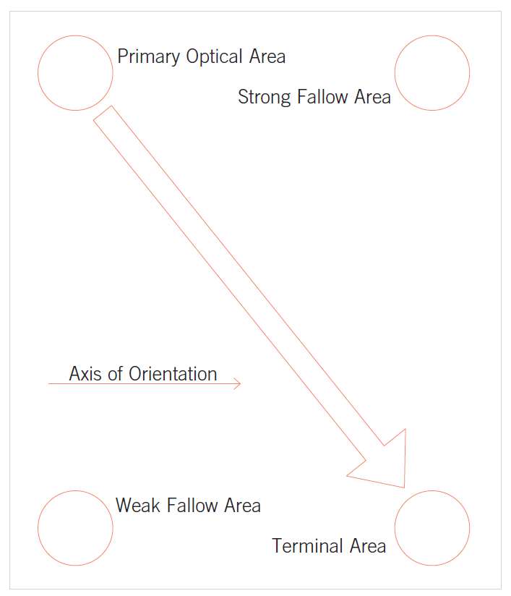
Gutenberg Diagram
A layout following the Gutenberg diagram would place key elements at the top left (e.g., headline), middle (e.g., image), and bottom right (e.g., contact information).

Slide 15
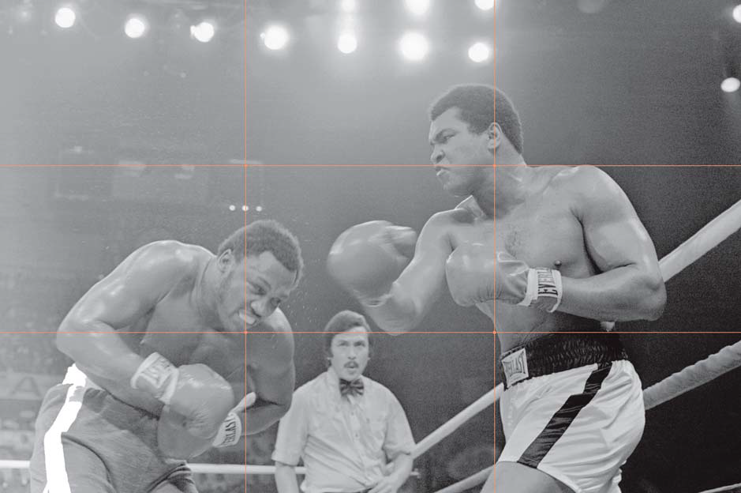
Rule of Thirds
It is applied by dividing a medium into thirds both vertically and horizontally, creating an invisible grid of nine rectangles and four intersections.
The primary element within a design is then positioned on an intersection of the grid.

Slide 16
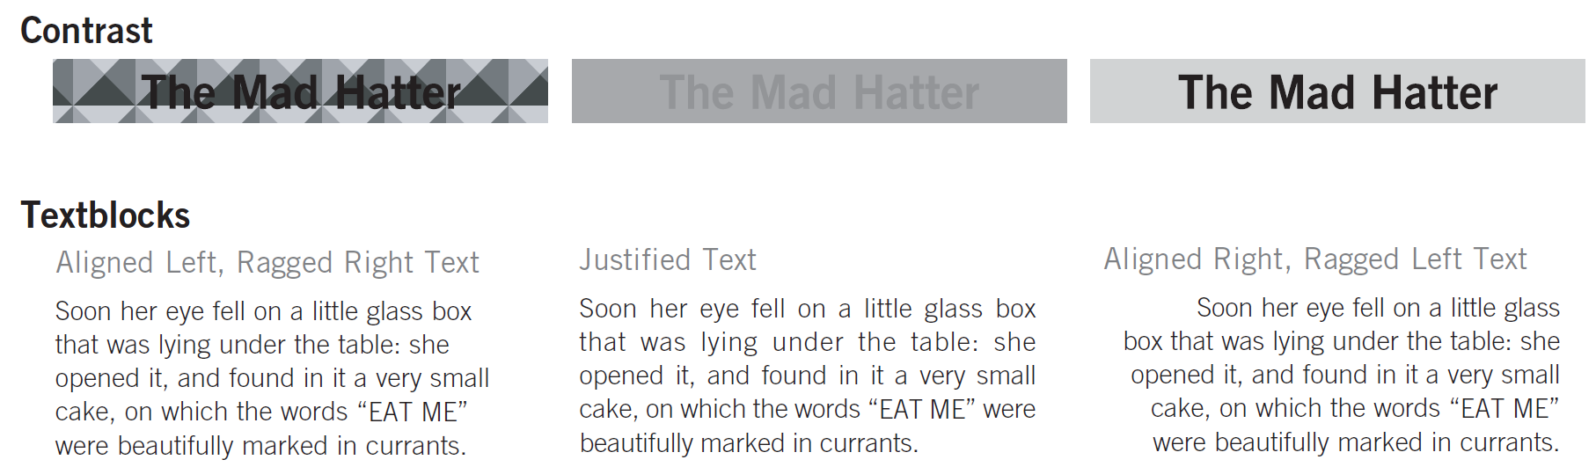
Legibility
The visual clarity of text, generally based on the size, typeface, contrast, text block, and spacing of the characters used.
For printed text, standard 9- to 12-point type is considered optimal.
Sentence case text should be used for text blocks.
Use dark text on a light background or vice versa.

Slide 17
Web Accessibility
Online testing tools
https://wave.webaim.org/
https://www.deque.com/
Testing tool for WordPress
https://wordpress.org/plugins/tool-for-ada-section-508-and-seo/
Testing tool for Chrome
https://chromewebstore.google.com/detail/wave-evaluation-tool/jbbplnpkjmmeebjpijfedlgcdilocofh
Testing tool for Firefox
https://addons.mozilla.org/en-US/firefox/addon/wave-accessibility-tool/

Slide 18
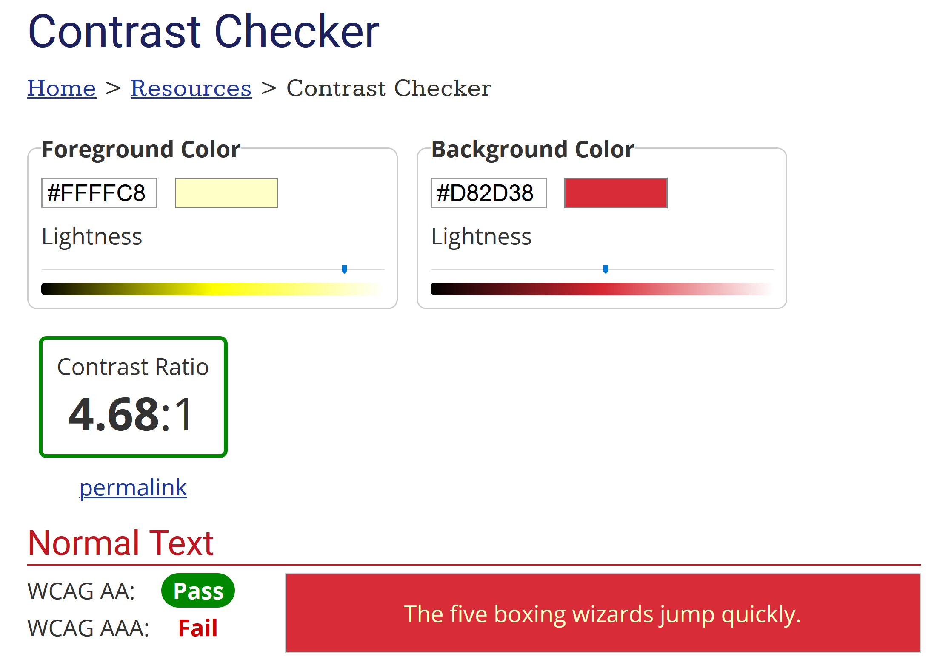
Background and Text Contrast
https://webaim.org/resources/contrastchecker/
Increase the contrast between the foreground (text) color and the background color.

Slide 19

Link Contrast
https://webaim.org/blog/wcag-2-0-and-link-colors/

Slide 20
Empty Link
Problem: An Empty Link error means that one of the links present on the web page is empty or contains no text describing where the link will go if clicked or triggered.
Solution: The aria-label attribute is used to define a string that labels the current element. Use it in cases where a text label is not visible on the screen.
<button aria-label="Close" onclick="myDialog.close()">
X
</button>

Slide 21

Further Reading
Ben Shneiderman et al. (2018). Designing the User Interface - Strategies for Effective Human. Pearson.
Jason Beaird and James George (2014). The Principles of Beautiful Web Design. SitePoint.
Don Norman (2013). The Design of Everyday Things. Basic Books.

Slide 22

Thank You & See You Again

